Slide 1

Urban partnership Projects
Presented by: Julie Robertson, UPP & CCS Program Manager
UPDirector@BCAAFC.com

Slide 2
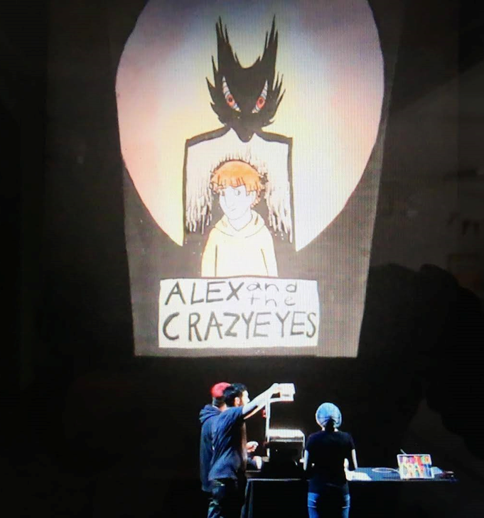
Urban Partnership Projects - Background
Funding through the BCAAFC, with funds from INAC
40 projects currently running throughout BC
Projects fall into one of three streams:
Innovation
Social Enterprise
Youth
Skookum Jim – Youth Stream UP Project

Slide 3
UP Project Information
Criteria
UP Project Goals
Who can apply – off reserve/urban projects
Funding timeline – April 1 – Mar 31
Funding for three streams
$ available overall - $3mil
$ available per project - $85K
Increased participation in the economy
Partnerships
Youth

Slide 4
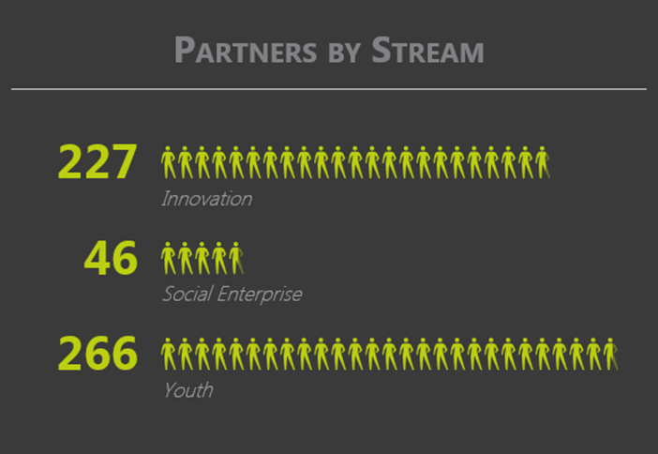
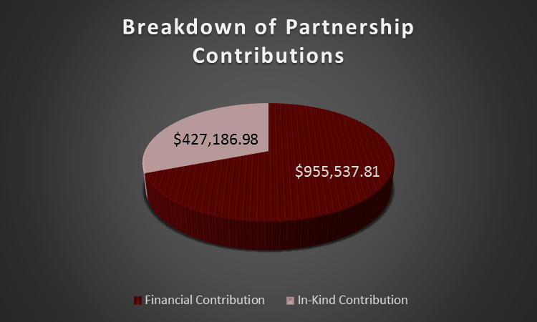
Partnership Information – 15/16 Fiscal figures
539 partners participated in UP projects in BC last year
1.38 Million Dollars in partnership contributions
$430,000 in In-Kind Contributions
$955,000 in direct financial contributions

Slide 5
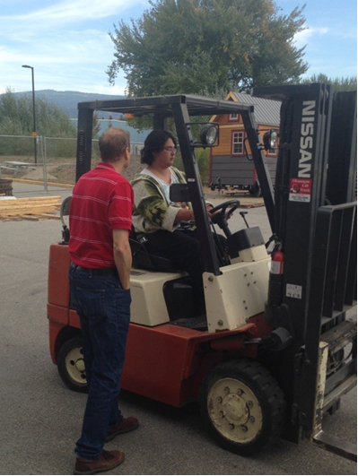
Innovation
Project Objectives:
A unique approach to anti-discrimination as it relates to removing or reducing barriers to economic participation and employment;
Removing or reducing barriers that prevent people from participating in the economy such as childcare and transportation;
Unique approaches to poverty reduction that remove or reduce barriers to participation in the economy;
Research on issues that prevent participation in the economy;
Culture-based projects that reduce or remove barriers to participation in the economy.
Ooknakane – Youth Stream UP Project

Slide 6
Social Enterprise
Project Objectives:
Organizational learning and capacity building for the support of social enterprise and social economy initiatives
Business start-up or pilot projects that have a strong focus on skill development
Expanding successful existing enterprises.
Type of social enterprise projects you can apply for:
Feasibility Study
Business Plan
Start-up
Expansion
Training

Slide 7
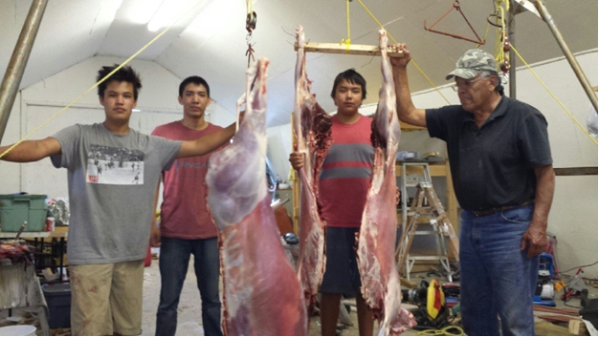

Youth – ages 16-24
Project Objectives:
Enhanced capacity of urban Aboriginal youth to be self-reliant through increased participation in the economy and lifelong labour force attachment;
Self-advocacy, systems navigation, healthy living, and life-skill development;
Educational supports, including mentoring and tutoring;
Skill acquisition and knowledge transfer, bridging to other employment training programs and opportunities, and self-employment supports.

Slide 8
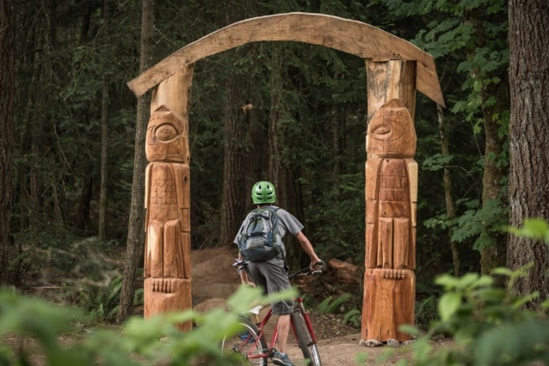
Innovation
Story Trails Project – Hiiye’yu Lelum House of Friendship – Duncan, BC
Mountain bike path
Literacy education
Carving
Elders support
Life skills
School District Partner

Slide 9
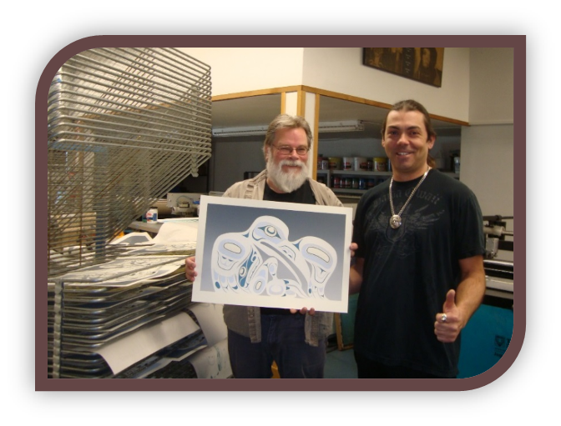
Social Enterprise
Wachiay Studios – Wachiay Friendship Centre – Comox, BC
Fully functional screen shop
T-shirts & other garments
Art lithographs
Online sales
Education programming
In schools – elementary & high schools
Summer camps
Adult training

Slide 10
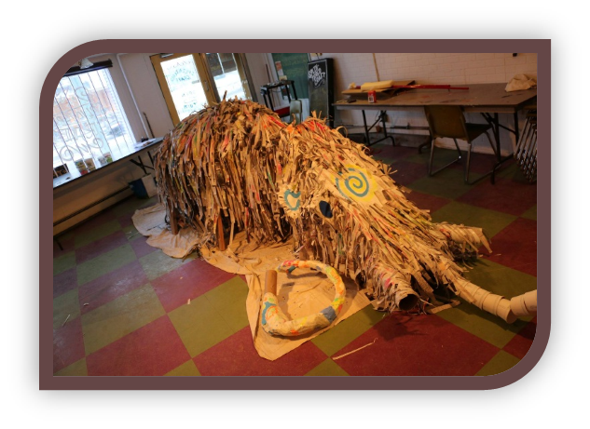
Youth
Splintered Craft – Skookum Jim Friendship Centre, Whitehorse, YK
Arts based
Art CV Development
Marketing Essentials
multimedia
Pre-employment training
Youth aged 16-24

Slide 11

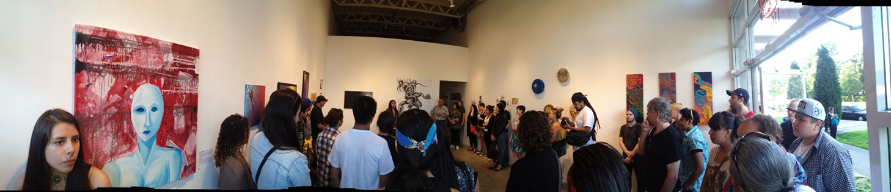
More Information:
Check out the UP Website at:
bcaafc.com -> Programs -> UP
http://www.bcaafc.com/programs/urbanpartnerships
Email: UPDirector@bcaafc.com
Phone: 250-388-5522 ext. 217
Victoria Native Friendship Centre – Youth Project
Urban Native Youth Association – Talking Stick Festival Showcase

